Slide 1
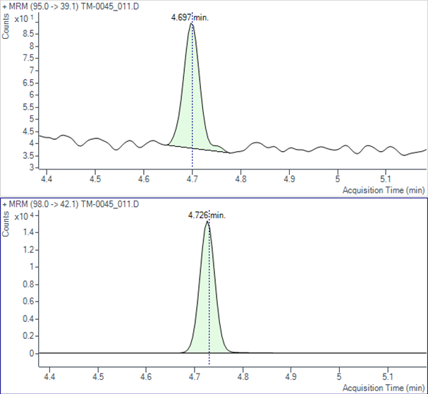
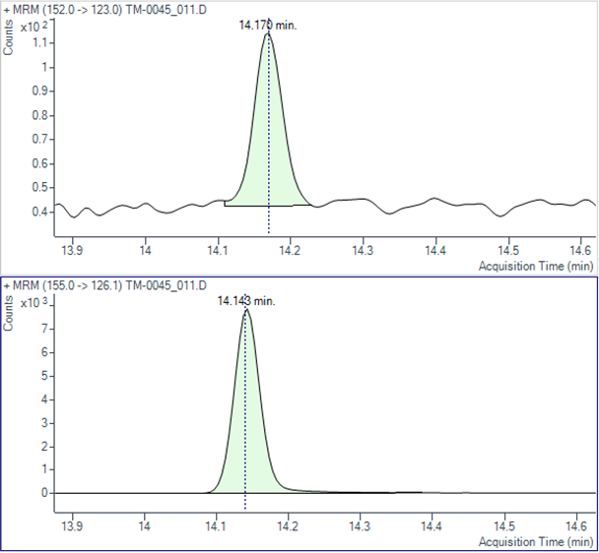
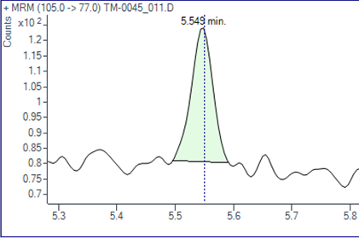
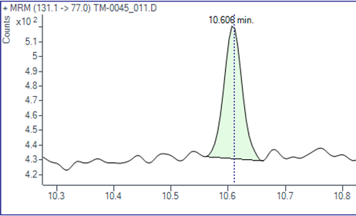
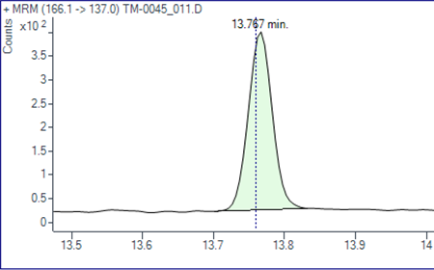
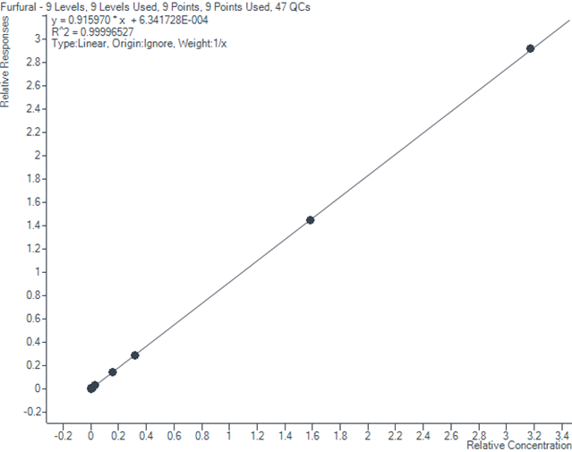
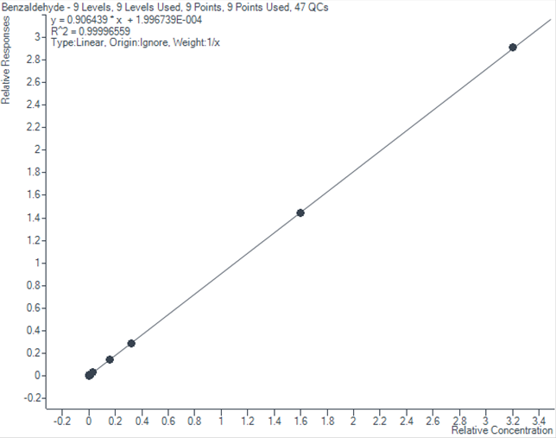
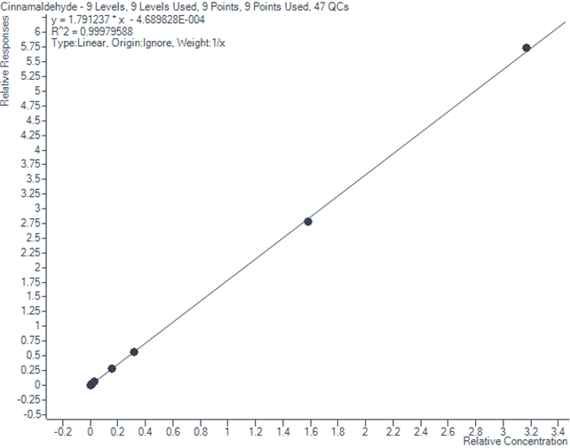
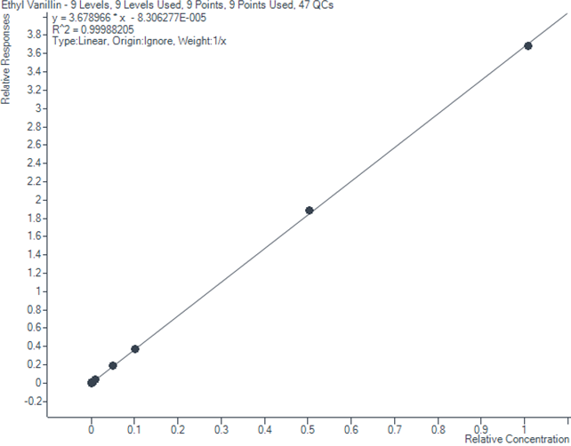
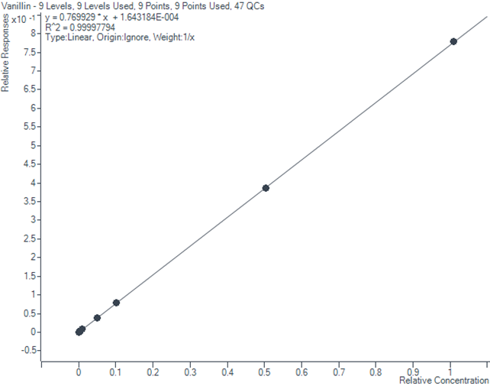
Analysis of Aromatic Aldehydes in E-Vapor Products
by GC-MS/MS
Leona Sirkisoon, Lewhy Via, Jeff Zhu, Rana Tayyarah
ITG Brands LLC, Greensboro, NC, USA
Abstract
Aromatic aldehydes (furfural, benzaldehyde, cinnamaldehyde, ethyl vanillin, and vanillin) are of interest for e-vapor products testing based on recent guidance from FDA-CTP. There are limited reports of direct application methods that include each of these analytes of interest in one method. Here we present a simple GC-MS/MS method for the analysis of these aromatic aldehydes in e vapor product aerosols and e-liquids with relatively low analyte LOQs. The method was developed using acetone as the solvent and 2,6-Di-tert-butyl-4-methylphenol (BHT) as an additive to prolong the stability of ethyl vanillin and vanillin. Split injection mode (50:1) is utilized and the thermostability of these compounds allowed for a high inlet temperature (325°C), which is necessary for rapid vaporization of the analytes and removal of propylene glycol and glycerol from the inlet. Additionally, optimization of the source temperature revealed that 350°C is most suitable for the five analytes of interest. The calibration range for furfural, benzaldehyde, and cinnamaldehyde is 8 to 8000 ng/mL, and 100 to 100000 ng/mL for ethyl vanillin and vanillin. Two internal standard compounds are used; Furfural-d4 for furfural, benzaldehyde and cinnamaldehyde, and vanillin-d3 for ethyl vanillin and vanillin. The LOQ of the method is defined as the lowest spiked analyte concentration during the validation which was 8.08 ng/mL, 0.003232 µg/puff for 50 puffs of aerosols, or 0.4489 µg/g of e-liquid for furfural, benzaldehyde, and cinnamaldehyde, and 101 ng/mL, 0.0404 g/puff for 50 puffs of aerosols, or 5.6111 µg/g of e-liquid for ethyl vanillin and vanillin. This new method was validated with good recoveries for e-vapor product aerosols (97 – 127%) and e-liquids (89 – 128%).
Mass Spectrometry Parameters
Transfer line temperature: 260°C
Source temperature: 350°C
Quadrupole 1 temperature: 150°C
Quadrupole 2 temperature: 150°C
MS Mode: EI/MRM
Nitrogen Collision Flow: 1.5 mL/min
Helium Quench Flow: 2.25 mL/min
Detector off: after 15 minutes
Quantitation Ions
Chromatograms for Standard Level 1
Furfural/Furfural-d4
Vanillin/Vanillin-d3
Analyte | Precursor Ion | Product Ion | Resolution | Dwell Time (ms) | Collision Energy | Retention Time (min) | Time Segment
Furfural | 95 | 39.1 | Wide | 100 | 20 | ~4.7 | 1
Furfural-d4 | 98 | 42.1 | Wide | 100 | 20 | ~4.7 | 1
Benzaldehyde | 105 | 77 | Unit | 100 | 20 | ~5.6 | 1
Cinnamaldehyde | 131.1 | 77 | Wide | 300 | 30 | ~10.6 | 2
Ethyl Vanillin | 166.1 | 137 | Unit | 100 | 15 | ~13.8 | 3
Vanillin | 152 | 123 | Unit | 100 | 15 | ~13.2 | 3
Vanillin-d3 | 155 | 126.1 | Unit | 100 | 20 | ~14.1 | 3
Benzaldehyde
Cinnamaldehyde
Ethyl Vanillin
Method
Aerosol from test e-vapor products is generated under conditions specified by the collection regime and collected on a glass fiber filter pad (Cambridge Filter Pad, CFP) with an in-line impinger containing acetone (ACON, 19.8 mL) that is immersed in a dry-ice/IPA bath. After aerosol collection, an aliquot of the internal standards solution (ISTD, 0.2 mL) is mixed with the impinger solution and transferred to a 40 mL amber glass vial. The CFP is added to the same glass vial and extracted using a shaker for 30 min (240 rpm). E-liquid (~0.36 g) is extracted with ACON (19.8 mL) in a 40 mL amber glass vial, after the addition of the ISTD solution (0.2 mL), using a shaker for 30 min (240 rpm). An aliquot of the extract is filtered and subsequently analyzed by GC-MS/MS (Agilent 8890/7000D) in positive electron ionization mode.
GC Conditions
GC column: HP-INNOWax – 30 m x 250 µm x 0.5 µm
Carrier gas: Helium at 1.0 mL/min constant flow
Septum Purge Flow: 3 mL/min
Inlet temperature: 325 °C
Injection mode: Split 50:1
Gas saver: 20 mL/min after 3 min
Injection volume: 1 µL
Column temperature: 40°C (hold 0.5 min), 110°C/min to 150°C (hold 4.5 min), 20°C/min to 230°C (hold1 min),
120°C/min to 260°C (hold 6.75 min)
Total runtime: 18.0 min
Results
Calibration Curves
Recoveries
Sample Type | Spike Level | Furfural | Benzaldehyde | Cinnamaldehyde | Ethyl Vanillin | Vanillin
Aerosol 1 | Low Spike | 110% | 99% | 108% | 115% | 109%
 | Mid Spike | 103% | 100% | 100% | 111% | 104%
 | High Spike | 101% | 100% | 98% | 106% | 101%
Aerosol 2 | Low Spike | 113% | 97% | 107% | 115% | 124%
 | Mid Spike | 102% | 98% | 99% | 111% | 104%
 | High Spike | 100% | 100% | 98% | 110% | 101%
E-Liquid 1 | Low Spike | 91% | 98% | 102% | 97% | 110%
 | Mid Spike | 99% | 99% | 103% | 105% | 102%
 | High Spike | 100% | 101% | 101% | 108% | 101%
E-Liquid 2 | Low Spike | 98% | 97% | 94% | 106% | 128%
 | Mid Spike | 98% | 100% | 99% | 105% | 103%
 | High Spike | 100% | 101% | 101% | 107% | 100%
Furfural
R² = 0.99997
Benzaldehyde
R² = 0.99997
Cinnamaldehyde
R² = 0.99980
Ethyl Vanillin
R² = 0.99988
Vanillin
R² = 0.99998
Conclusions
ITG Brands has developed a GC-MS/MS method for the analysis of aromatic aldehydes in e-vapor product aerosols and e-liquids with simple sample preparations and 18.0 minutes instrument run time. It covers five aromatic aldehydes in one method with relatively low analyte LOQs. The new method was validated with good accuracies and is used for routine testing of commercial e-vapor products.
References
Premarket Tobacco Product Applications for Electronic Nicotine Delivery Systems - Guidance for Industry, FDA Center for Tobacco Products, June 2019.
S/N at Low Standard levels
*: to quantitate the concentrations around LOQ levels
Level | Furfural | Benzaldehyde | Cinnamaldehyde | Ethyl Vanillin | Vanillin
Std 0.75* | 39 (6 ng/mL) | 17 (6 ng/mL) | 16 (6 ng/mL) | 139 (75 ng/mL) | 30 (75 ng/mL)
Std 1 | 41 (8 ng/mL) | 16 (8 ng/mL) | 18 (8 ng/mL) | 181 (100 ng/mL) | 33 (100 ng/mL)

