Slide 1
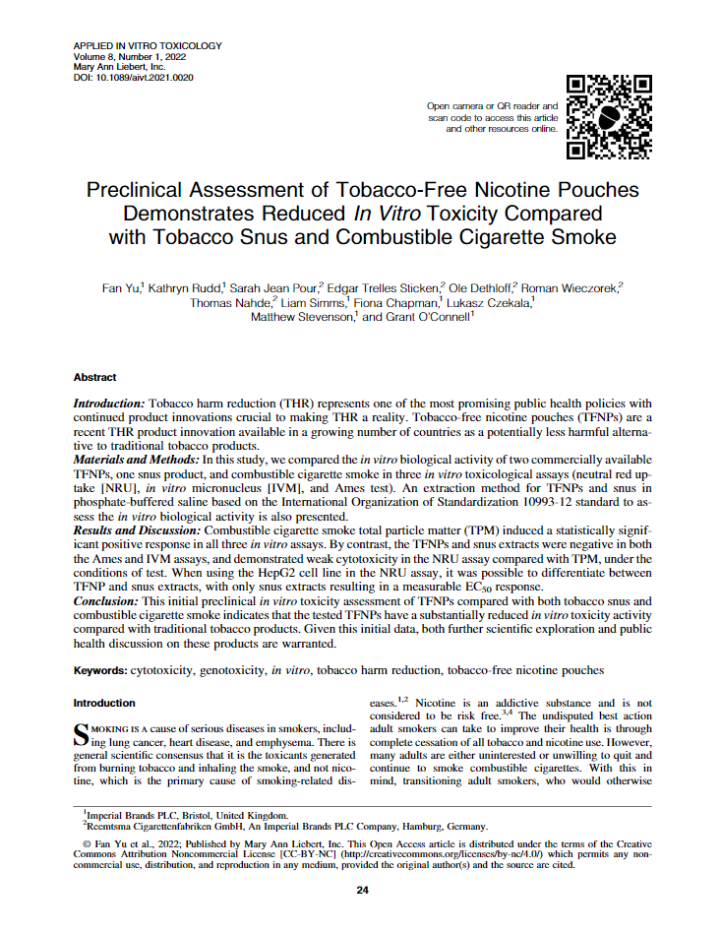
Preclinical Assessment of Tobacco-Free Nicotine Pouches Demonstrates Reduced In Vitro Toxicity Compared with Tobacco Snus and Cigarette Smoke
Roman Wieczorek
IIVS Virtual Workshop | 25th January 2024
Disclaimer: Please note that the views and arguments in this presentation have been designed to encourage and stimulate debate and do not necessarily reflect Imperial Brands’ position

Slide 2
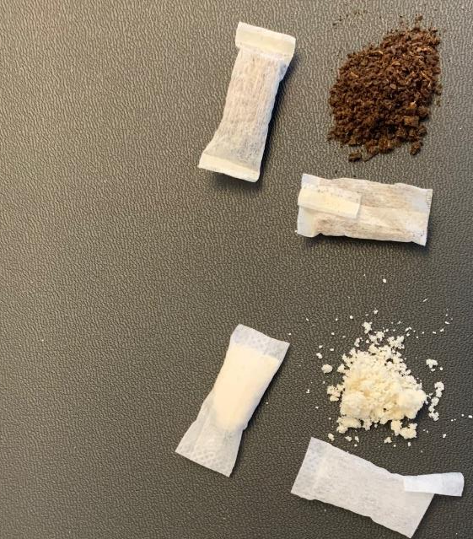
Introduction – test products
Tobacco harm reduction (THR) represents one of the most promising public health policies with continued product innovations crucial to making THR a reality.
Tobacco-free nicotine pouches (TFNPs) have a similar appearance and oral route of use to that of traditional tobacco-containing Scandinavian Snus.
Typically, TFNPs are small pouches containing high-purity pharmaceutical grade nicotine sprayed onto a plant fiber-based substrate. They also contain other high-quality ingredients, including flavorings, humectants to retain moisture, and additives to ensure product stability.
Pouch with tobacco
- Snus -
Pouch with plant fiber
- TFNP -

Slide 3
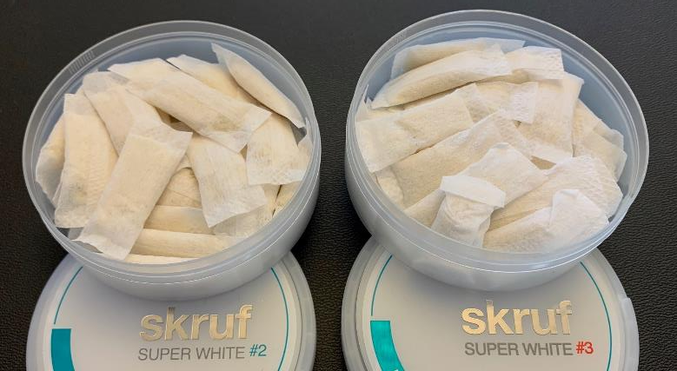
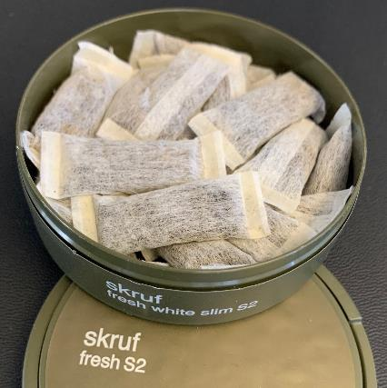
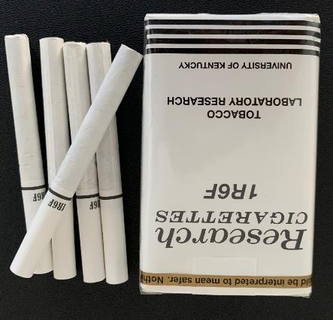
Description of test products
(Imperial Brands products not sold in the U.S.)
TFNPs
Snus
1R6F
ª From combusted cigarette data.

Slide 4
Sample preparation - extraction techniques
A range of extraction techniques have been reported for the testing of oral tobacco products (such as Snus), including PBS, DMSO, cell media, and complete artificial saliva. Each have their own advantages and limitations.
Artificial saliva and cell media are highly variable between batches and suppliers, making it challenging to generate a uniformed exposure system.
The chemical simplicity of PBS allows for the generated extract to be quantified for nicotine without any potential confounding interference due to cell medium constituents, for example, protein binding, and can be used in multiple, independent assays (different assays will require different cell medium).

Slide 5
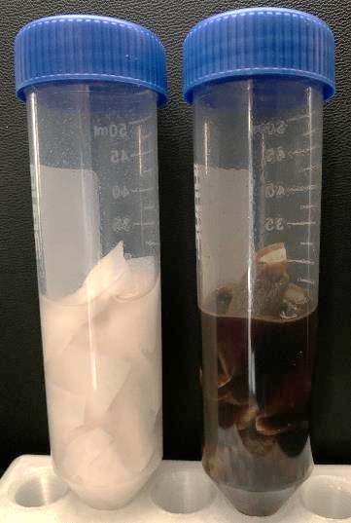
Extract generation - TFNP and snus
TFNPs and Snus extracts were generated based on - Biological evaluation of medical devices ISO 10993-12 for exaggerated extraction.
In brief,
6 g of TFNPs or Snus were covered with 20 mL phosphate-buffered saline (PBS) as extraction medium in a 50 ml tube (~ 300 mg/mL)
This was then agitated at 600 rpm for 1 hour
The solution was then centrifuged and ﬁltered through 0.45 and 0.2 µm sterile ﬁlters
Aliquots of 500 µL per extract were frozen at -80°C
Three independent extracts for each OND test article were generated. Nicotine was used as a marker for evaluating extraction efﬁciency.
The average extraction efﬁciency in this study was 66%–75%.
TFNP#3
Snus
OND, Oral Nicotine Delivery

Slide 6
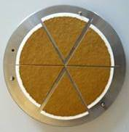
Extract generation
Total particulate matter (TPM) of 1R6F
cigarettes were conditioned at 22°C and 60% relative humidity according to the ISO standard 3402
after conditioning the cigarettes were smoked according to the ISO 3308 (35 ml puff volume/ 2 sec puff duration/ 60 sec interval/ bell shape puff profile, no ventilation block)
Cigarette Smoke Condensate (CSC)
collected on a Cambridge filter
H₂O and nicotine
analysis
extraction of CSC in
DMSO for in vitro tests → TPM
Nicotine content of TPM in DMSO, TNFP, and Snus PBS Extracts
Product extracted mg nicotine/mL solvent (±SD; n=3)
TFNP #2 PBS 1.70 ± 0.07 mg/mL PBS
TFNP #3 PBS 2.51 ± 0.15 mg/mL PBS
Snus PBS 2.59 ± 0.10 mg/mL PBS
1R6F TPM 1.35 mg/mL DMSO

Slide 7
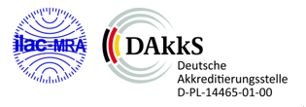
In vitro Methods
TPM, Snus and TFNPs extracts were tested in three in vitro toxicological assays:
NRU - neutral red uptake in 96 MWP in serum free medium over 65h incubation
BEAS-2B (ECACC; Cat.No.:95102433), human bronchial epithelial cells
HepG2 (ATCC, Cat.No.:HB8065), human hepatoma cells
IVM - in vitro micronucleus in 24 MWP
V79 (ECACC;Cat.No.:86041102), hamster lung cells
Ames test
5 Salmonella typhimurium strains: TA98, TA100, TA102, TA1535, and TA1537
All the methods are ISO17025 accredited
MWP, Multiwell Plate

Slide 8
NRU - cytotoxicity
BEAS-2B
HepG2
EC50
EC20
All extracts showed statistically significant cytotoxicity, as determined by achievement of >20% cytotoxicity (EC20).
In terms of EC20, 1R6F TPM was at least 167 times more cytotoxic than TFNPs, and Snus, in both cell lines (table right).
A difference in sensitivity between the two cell lines was observed. HepG2 cells appeared to detect cytotoxicity at a lower concentration than BEAS-2B cells for all the test items.

Slide 9
NRU - comparison to nicotine cytotoxicity
BEAS-2B
HepG2
The cytotoxicity induced by increasing concentrations of 1R6F TPM, TFNPs and Snus extracts in the NRU assay was compared to nicotine cytotoxicity on an extract nicotine concentration basis.
The cytotoxicity data, particularly with HepG2 cells, suggest that the tobacco-free products may offer greater tobacco harm reduction potential than Snus.
The corresponding nicotine concentrations for the top dose were: 57 (TFNP #2), 84 (TFNP #3), and 86 µg (Snus) nicotine/mL, these nicotine concentrations were similar to the nicotine levels found in the saliva of moist snuff users (73 µg nicotine/mL *).
* Hoffmann D, Adams JD. Carcinogenic tobacco-specific N-nitrosamines in snuff and in the saliva of snuff dippers. Cancer Res 1981:41(Pt 1);4305–4308.
Zanetti F, et al. Assessment of a 72-hour repeated exposure to Swedish Snus extract .. . Food Chem Toxicol 2019:125;252–270.

Slide 10
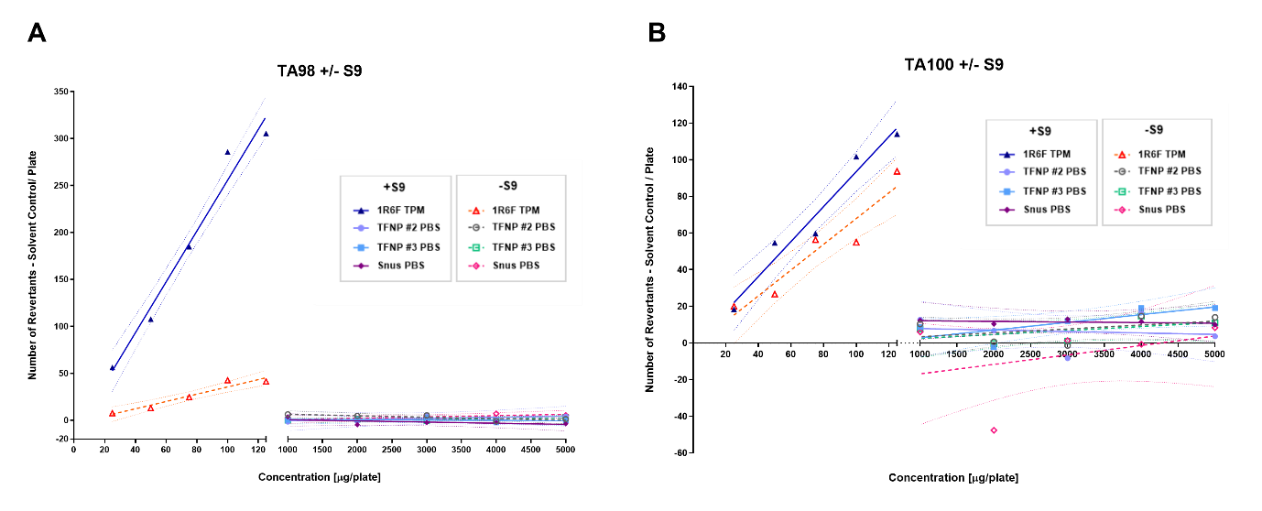
Ames mutagenicity
TA98+/-S9
TA100+/-S9
No dose-dependent or statistically significant increases in revertant frequencies were observed for TFNPs and Snus extracts in any of the five S. typhimurium strains (TA98, TA100, TA102, TA1535, and TA1537) with or without S9 metabolic activation, when compared with the negative controls.

Slide 11
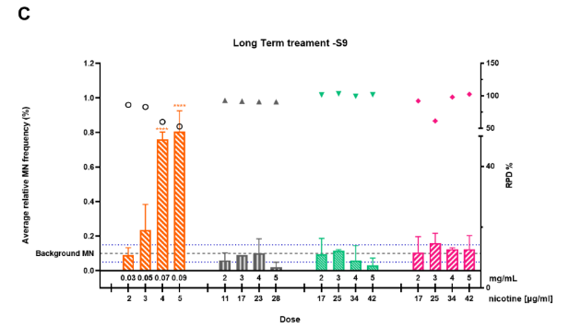
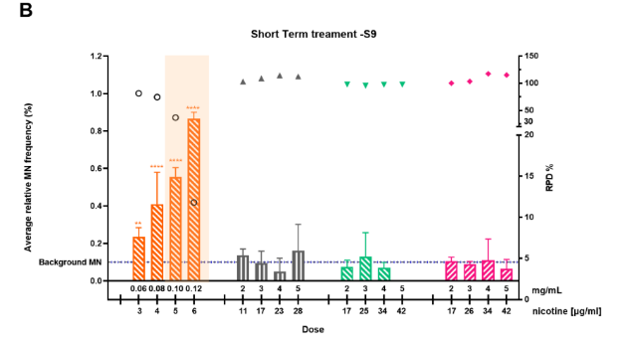
IVM – genotoxicity
short-term treatment +S9
Short-Term Treatment +S9
Long-Term Treatment -S9
Short-Term Treatment -S9
1R6F TPM indicated in all three treatment conditions a strong genotoxic response.
No genotoxic response were observed for TFNPs and Snus extracts
IVM, in vitro micronucleus; RPD, relative population doubling; SD, standard deviation; **p ≤ 0.01, ***p ≤ 0.005, ****p ≤ 0.0001

Slide 12
Conclusion
To our knowledge this was the first study to assess the preclinical in vitro responses of TFNP extracts in OECD established assays.
Cigarette smoke induced strong responses in all three assays.
TFNP and Snus extracts show more than 150 times lower cytotoxicity in NRU assay than 1R6F cigarette TPM.
TFNP and Snus extracts demonstrated no response in the in vitro toxicological assays for genotoxicity (IVM and Ames tests) under the assessed conditions.
The results presented here add to the growing body of scientific evidence supporting a positive role for TFNPs in THR strategies; however, further chemical characterization, preclinical, clinical, and perception and behavior studies are required for a fuller scientific substantiation.
The data from the present study indicate that the assessed TFNPs offer promising THR potential, even more than the already established harm reduction profile of Snus, when used by adult smokers as an alternative to smoking cigarettes.

